Slide 1
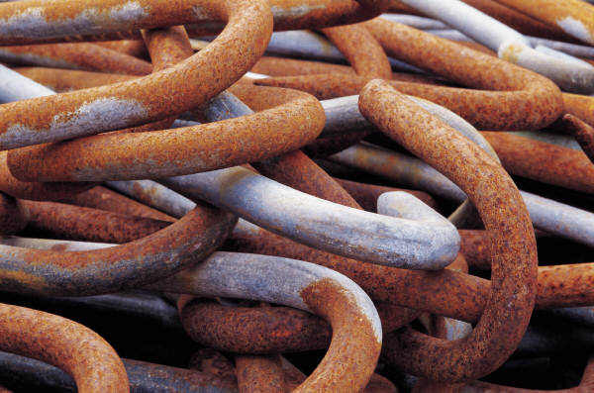
Metal Reactivity
Revision

Slide 2
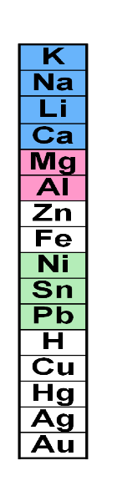
Arrange the metals in order of their reactivity
Potassium K
Sodium Na
Lithium Li
Calcium Ca
Magnesium Mg
Aluminium Al
Zinc Zn
Iron Fe
Nickle Ni
Tin Sn
Lead Pb
Copper Cu
Mercury Hg
Silver Ag
Gold Au
Platinum Pt

Slide 3
Reactivity Series
Potassium (Pretty) Lead (Lovely)
Sodium (Sally) Hydrogen (Honolulu)
Lithium (Little) Copper (Causing)
Calcium (Could) Mercury (Many)
Magnesium (Marry) Silver (Strange)
Aluminium (A) Gold (Glances)
Zinc (Zulu)
Iron (In)
**Based on reactions with acid, air and water

Slide 4
Reactivity Series
metals
The Reactivity Series puts the metals in order of reactivity .The highly reactive metals react with cold water, giving off Hydrogen gas and leaving an alkaline solution. Metals of medium reactivity only react very slowly with cold water, but they react well with steam. These metals fizz with dilute acid giving off Hydrogen gas. Metals of low reactivity, such as Copper, silver, Gold and platinum do not react with water or dilute acid . A more reactive metal can displace a less reactive metal from its compounds.
reactivity
Hydrogen
alkaline
slowly
steam
acid
Hydrogen
Copper
Gold
acid
displace

Slide 5
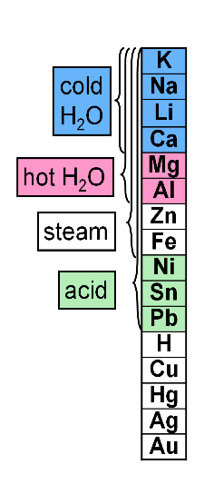
Q: will Mg react with H₂O?
No for cold, yes if it is hot/steam
Mg + H₂O --> H₂ + Mg(OH)₂
Zn + HCl --> H₂ +ZnCl₂
Other reactions:
Al + H₂O(steam) -->H₂ + Al(OH)₃
Cu + H₂O --> No Reaction (NR)
Ca + H₂SO₄ --> H₂ + CaSO₄
Na + H₂O --> H₂ + NaOH

Slide 6
Hydrogen can be placed in the reactivity series also
Potassium K
Sodium Na
Lithium Li
Calcium Ca
Magnesium Mg
Aluminium Al
Zinc Zn
Iron Fe
Tin Sn
Lead Pb
Copper Cu
Silver Ag
Gold Au
Platinum Pt
Metals above Hydrogen will displace it from its compounds (will react with water, steam or acid)
Hydrogen
Metals below Hydrogen will not displace it

Slide 7
Carbon can be placed in the reactivity series also
Potassium K
Sodium Na
Lithium Li
Calcium Ca
Magnesium Mg
Aluminium Al
Zinc Zn
Iron Fe
Tin Sn
Lead Pb
Copper Cu
Silver Ag
Gold Au
Platinum Pt
Metals above Carbon cannot be extracted from ores by heating with Carbon
Carbon
Metals below Carbon can be extracted from ores by heating with Carbon

Slide 8
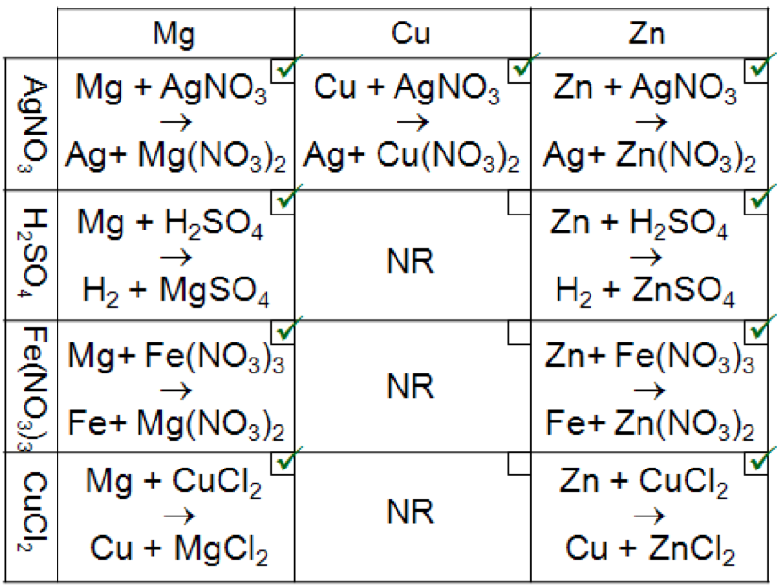
Lab involving reacting substance on top and sides…

Slide 9




Copper
Zinc Sulphate
Zinc + Copper Sulphate ………… + ………...
SO₄
SO₄
+
+
Iron
Magnesium Oxide
Magnesium + Iron oxide ………..…….. + …………..………...
O
O
+
+

Slide 10
Making salts
What acid would you react with Magnesium to form Magnesium Sulphate?
Sulphuric Acid
What chemical would you react with nitric acid to form Zinc nitrate, Carbon dioxide and Water?
Zinc Carbonate
What salt would form if Aluminium hydroxide was reacted with Nitric acid?
Aluminium nitrate

Slide 11
What will happen if silver is added to Hydrochloric acid?
No reaction
Can Carbon be used to extract magnesium from Magnesium oxide?
No, Magnesium is more reactive than Carbon
Can lead be extracted from its ore by Carbon?
Yes, Lead is less reactive than Carbon

Slide 12

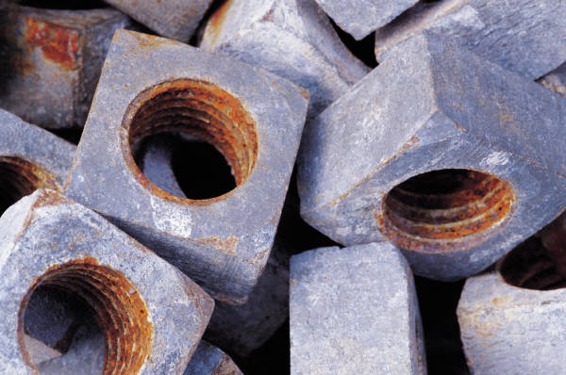
Rusting of Iron
Air and water are both present
The iron rusts
Only air is present
Rusting does not occur
Only water is present
(boiled water to remove the dissolved air in it)
Rusting does not occur

Slide 13
